Slide 1

Python Project
By Brian soh(31), Soon Teck(12), Linus(5)

Slide 2
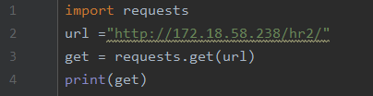

Performing a “get” request
We are trying to get a response from our website which is http://172.18.58.238/hr2/

Slide 3
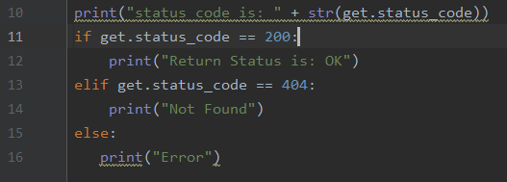

Display an “OK” return status
We will print the status code which the website will return to us and run it through the filters according to our script

Slide 4
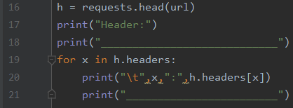
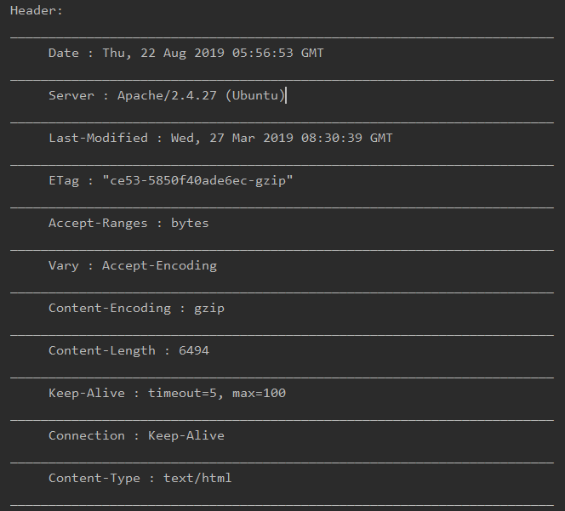
Display the Website header
We are requesting for the website header

Slide 5
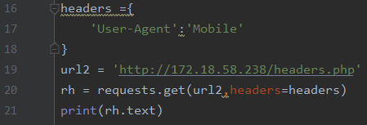
Modify the Header user-agent to display “Mobile”
Changing the User agent

Slide 6
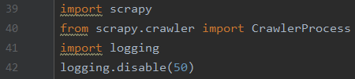

Miscellaneous
We are imported scrapy and logging to scrape our website for images and remove unnecessary information For global website we did it so we can use variable website in the whole script for convivence

Slide 7

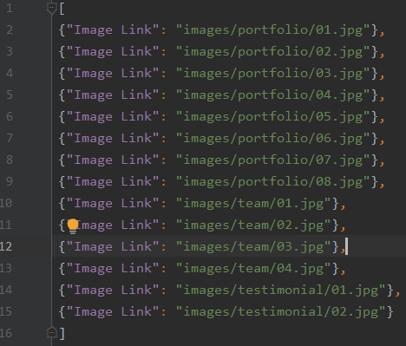
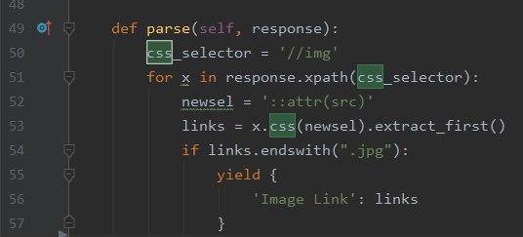
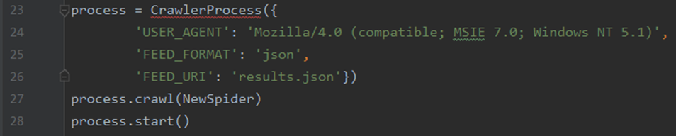
Scraping and extracting the images from the Website to store in results.json using crawler process

Slide 8
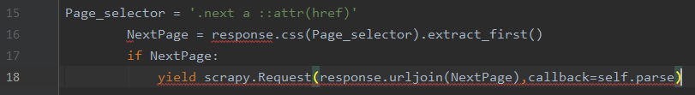
Recursively look into other link to extract jpg image.
this is to check the next page for images and scrap them out

Slide 9
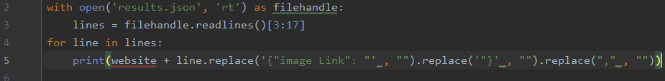
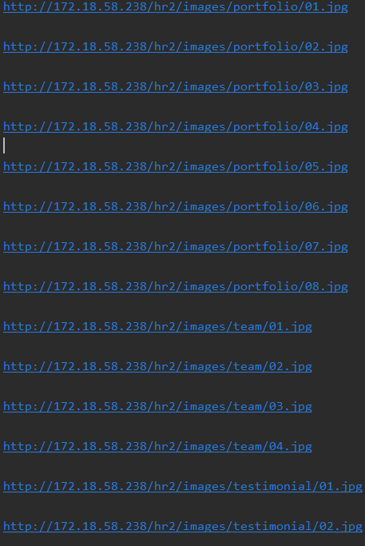
Displaying the results.json file when the script runs

Slide 10
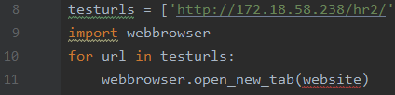
Testing our Website
We are displaying our website to show that it works

Slide 11
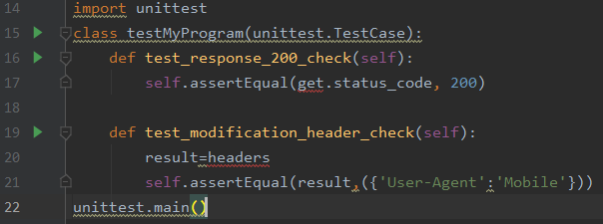
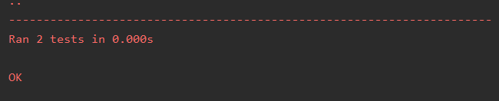
Unit Testing
We tested the website response and header and check that they are correct

Slide 12
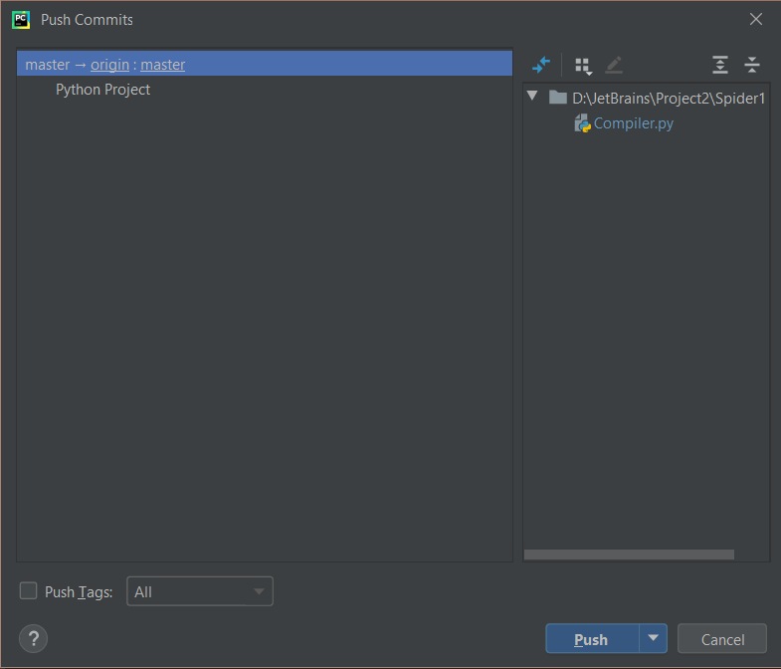
Version Control Systems
Hover over VCS, then click commit.
Then select which one you want to push.

Slide 13
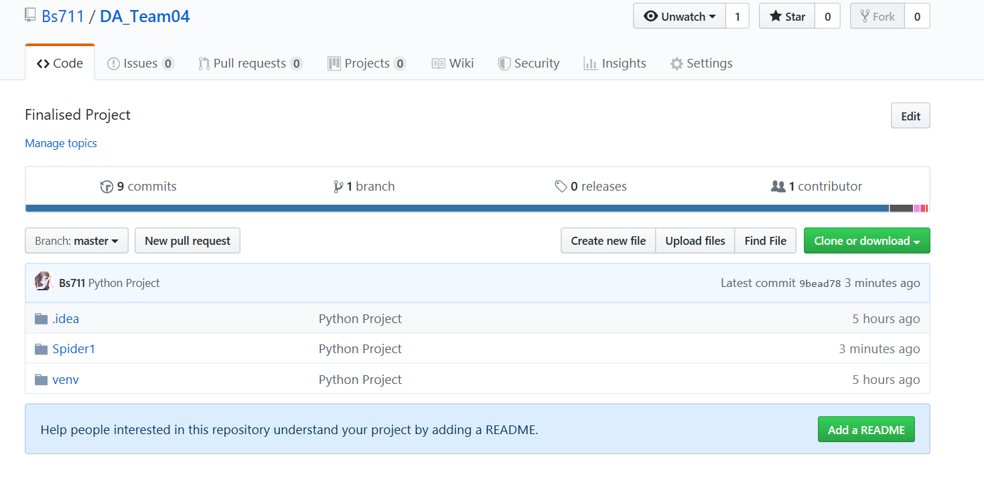
VCS Control Systems
Go to Github and go to the repositories.

